Slide 1
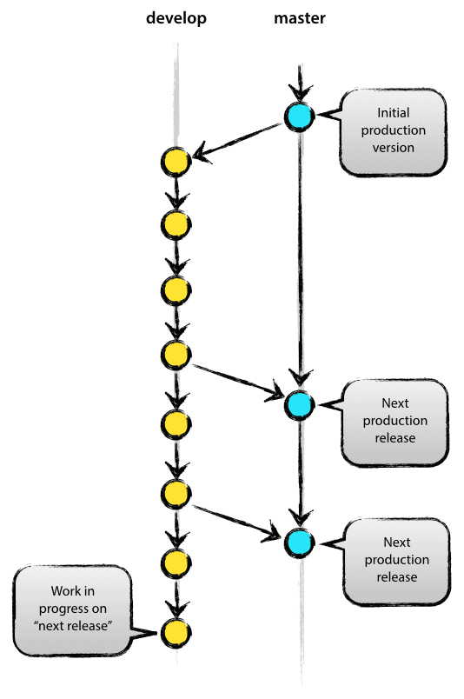
The Main Branches
The central repo holds two main branches with an infinite lifetime:
master
This is main branch where the source code of HEAD always reflects a production-ready state.
Each time when changes are merged back into master, this is a new production release by definition
develop
This is also to be main branch where the source code of HEAD always reflects a state with the latest delivered development changes for the next release.
This will act as Parent to the feature branches.
When reaches to stable point and is ready to be released , all of the changes should be merged back into master somehow and then tagged with a release number.

Slide 2
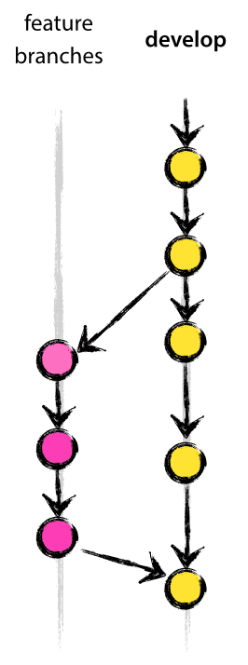
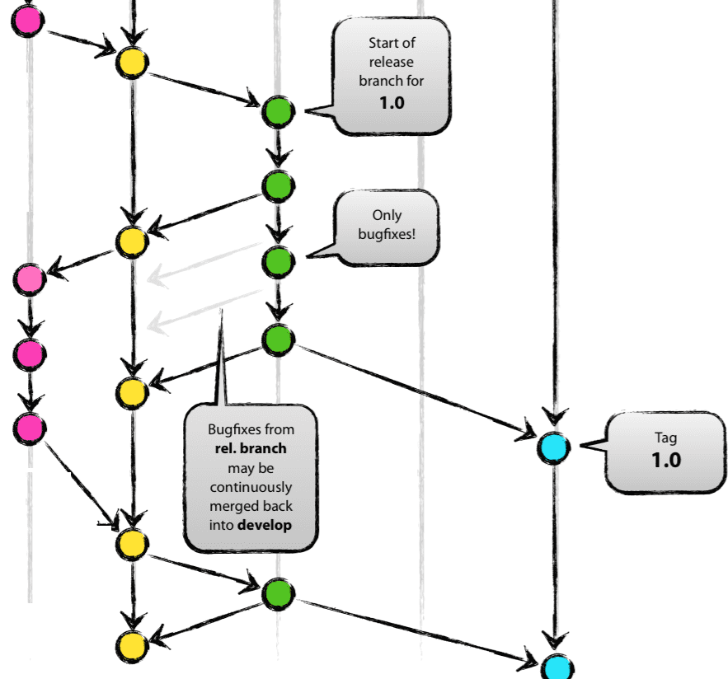
Supporting branches
Supporting branches to aid parallel development between team members, ease tracking of features, prepare for production releases and to assist in quickly fixing live production problems.
The different types of branches we may use are:
Feature branches
develop new features for the upcoming or a distant future release.
feature branch code in the local workspace (developers’ desktop or laptop).
May branch off from: develop
Must merge back into: develop
Branch naming convention: anything except master, develop, release-*, or hotfix-*
On a daily basis or regular intervals, fetch and merge changes from develop branch to the local feature branch.
merge the feature branch into “develop” branch.
Release branches
Release branches support preparation of a new production release.
Allow bug fixes and preparing meta-data for a release (version number, build dates, etc.).
May branch off from: develop
Must merge back into: develop and master
Branch naming convention: release-*
feature
branches
develop
release
hotfixes
master

Slide 3
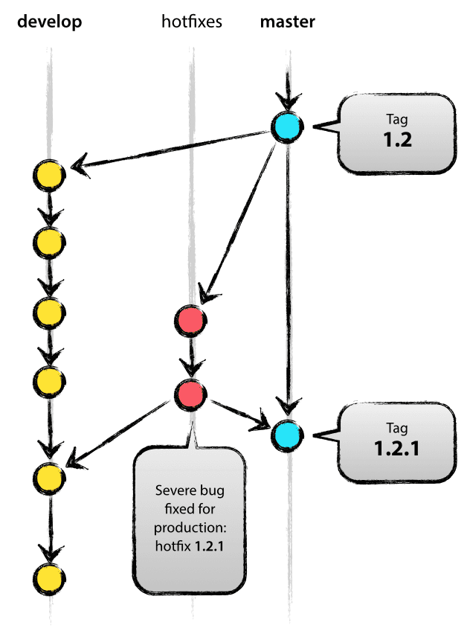
Supporting branches (contd.,)
hotfixes
When a critical bug in a production version must be resolved immediately, a hotfix branch may be branched off from the corresponding tag on the master branch that marks the production version.
May branch off from: master
Must merge back into: develop and master
Branch naming convention: hotfix-*

Slide 4
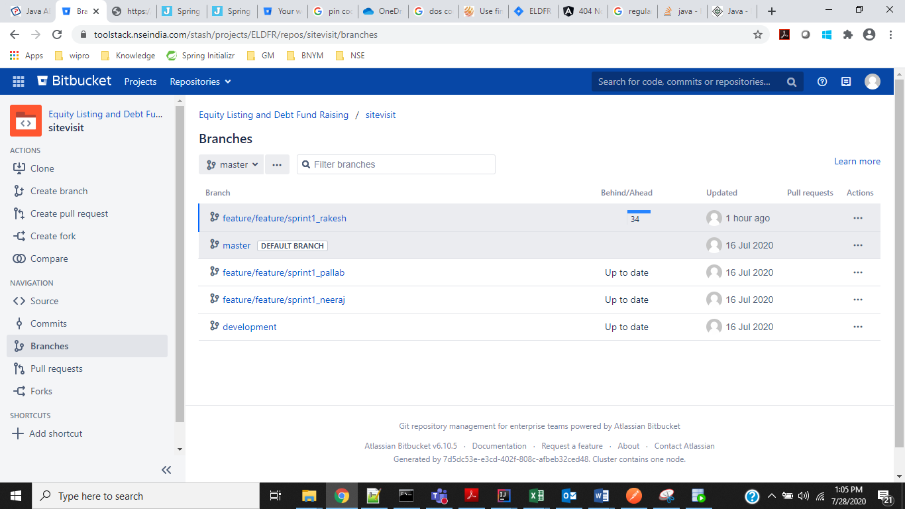
Naming Conventions:
Naming Conventions for projects:
Service: < Service >
UI: :<Service>ui
Branching Naming conventions for development
Development branch (it will be at garage level): development
Feature Branch: feature/<jira_id>
Other branches will be taken care by DevOps team. Will follow the process, which has been defined by DevOps after development branch merging done.
Code review:
Code review will be done by lead once
team member create pull request to
merge the code from feature branch to
Development branch. Once code review
complete team lead approve merge and
merge the code in development
environment.
Branches:

Slide 5
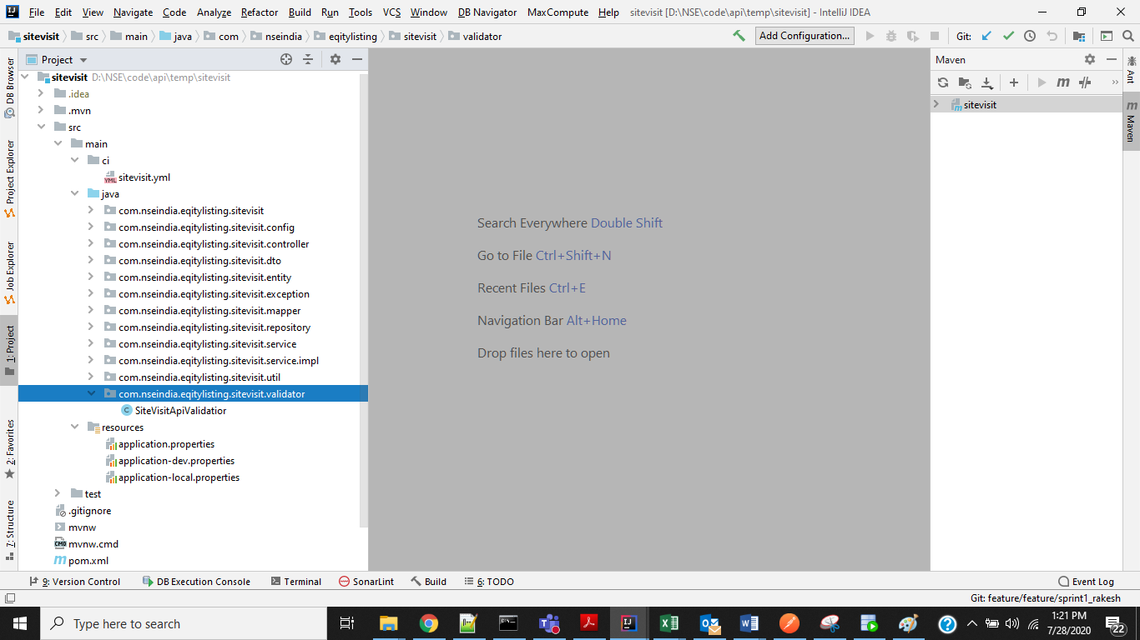
Naming Conventions (contd.,)
Project Structure:
The project Structure will be having below naming conventions.
Service
Src
main
ci
<service>.yml
java
com.nseindia.<garage>.<service>
com.nseindia.<garage>.<service>.config
com.nseindia.<garage>.<service>.controller;
com.nseindia.<garage>.<service>.dto; or com.nseindia.eqitylisting.sitevisit.model (it has to be confirm)
com.nseindia.<garage>.<service>.entity;
com.nseindia.<garage>.<service>.exception;
com.nseindia.<garage>.<service>.mapper;
com.nseindia.<garage>.<service>.repository;
com.nseindia.<garage>.<service>.service;
com.nseindia.<garage>.<service>.service.impl;
com.nseindia.<garage>.<service>.util;
com.nseindia.<garage>.<service>.validator;
resources
pom.xml

Slide 6
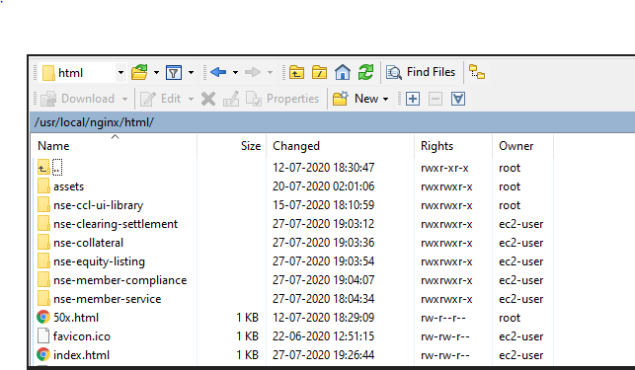
Naming Conventions (contd.,)
UI Project Structure:

Slide 7
Proposed NSE Branches and Environments
Branches
Dev Branch
Release Branch
Master Branch
Phases
Sprint
UAT
Deploy
Environments
Development
QA
UAT
Production
Development and Unit testing
Fix observations
Unit testing automation using JUNIT Framework
Place daily builds into QA environment
Smoke test in QA
QA and Integration testing
Testing automation.
Defects fixes
Post QA, the builds can be placed into UAT environment.
Sprint Demos
Smoke test in UAT environment
Regression testing suite execution by CI/CD pipeline (Unit test auto scripts + testing auto scripts)
System/Technical demo to Architects
Fix observations
Code merges into release branch
UAT Testing by Business Users
Performance & Security testing
Defects fixes
Final demo to NSE teams by BAs/ Customer Journey owners to NSE teams
Post UAT, the approved code will be merged into master and develop branches
Deploy master builds into to Production environment and do the Smoke test.
Prod Support
Fixes in both master and development branches
Activities

Slide 8
Best Practices
Use the standard Source Control folder-structure correctly for all Garages
Do merges regularly after code reviews are done.
Predict release dependencies
Daily check-out/check-in process in feature branch and do the smoke test
Push the feature branch code into development branch regularly and do the smoke test
Pull the code from development branch into feature branch before start of the development.

